Slide 1
SalesGenie
AI-Powered Sales Assistant
SalesGenie
AI-Powered Sales Assistant
Mahesh Zade
Special Thanks to Gautam Muthukumar for completing the Project and the Interview Kickstart team
SalesGenie • Mahesh Zade • 1/25

Slide 2
Executive Summary
A grounded, observable multi-agent sales workflow
01 AUTOMATE
02 PERSONALIZE
03 OBSERVE
Reduce manual inquiry reading and data entry.
Recommend products using customer needs and budget.
Trace agent calls and evaluate quality.
Core path: ingest → qualify → recommend → respond
Separate weekly aggregation is required by the capstone
Current export demonstrates the first four agent stages
SalesGenie • Mahesh Zade • 2/25

Slide 3
Business Context
Oak & Ember Interiors is pursuing AI-enabled sales productivity
Oak & Ember Interiors: home and office furniture retail
Nationwide showrooms and logistics network
AI goals: 24/7 engagement, personalized recommendations, simpler sales operations
BUSINESS VALUE
AI VALUE
Faster response + better sales productivity
Repeatable, observable decisions
SalesGenie • Mahesh Zade • 3/25

Slide 4
Problem Statement
Manual intake, inconsistent scoring and delayed insights
Sales reps spend 2–3 hours daily reading inbound inquiries
Manual Excel entry creates mistakes, duplicates and omissions
Product matching is time-consuming and error-prone
No standardized lead scoring
CRM logging is not real-time
Weekly sales insights take about half a day every Friday
SalesGenie • Mahesh Zade • 4/25

Slide 5
Target Outcomes
Automate repetitive work without sacrificing grounding
LEAD QUALIFICATION
RECOMMENDATION
INSIGHTS
Extract fields and classify Hot / Warm / Cold
Return catalog-grounded products with rationale
Produce structured weekly sales summaries
Guardrail: never invent product features, prices or availability
Extended path: customer-ready follow-up drafting
SalesGenie • Mahesh Zade • 5/25

Slide 6
Users & Stakeholders
Who benefits and who makes the decisions
Decision makers: CTO / software leadership, sales leadership, sales operations / CRM owner
Users: sales representatives and managers
PM/TPM responsibilities: scope, agent boundaries, evaluation, rollout, risk and observability
ORG-WIDE BENEFIT
PM/TPM BENEFIT
Consistency • speed • visibility
Measurable AI product governance
SalesGenie • Mahesh Zade • 6/25

Slide 7
Q1 — Three Agentic Interventions
Where agents can improve the sales funnel
01 INTAKE
02 QUALIFY + MATCH
03 RESPOND + REPORT
Automate extraction from inbound inquiry emails.
Metric: field completeness
Risk: bad extraction propagates.
Standardize lead tier and catalog matching.
Metric: tier accuracy
Risk: hallucination.
Draft replies and automate weekly insights.
Metric: turnaround time
Risk: unsupported claims.
SalesGenie • Mahesh Zade • 7/25

Slide 8
Solution Overview
From inbound inquiry to customer-ready response
Inbound email
↓
Email Ingestion Agent
↓
Lead Qualifier Agent
↓
Product Recommender Agent + catalog
↓
Response Drafter → customer-ready response
SalesGenie • Mahesh Zade • 8/25

Slide 9
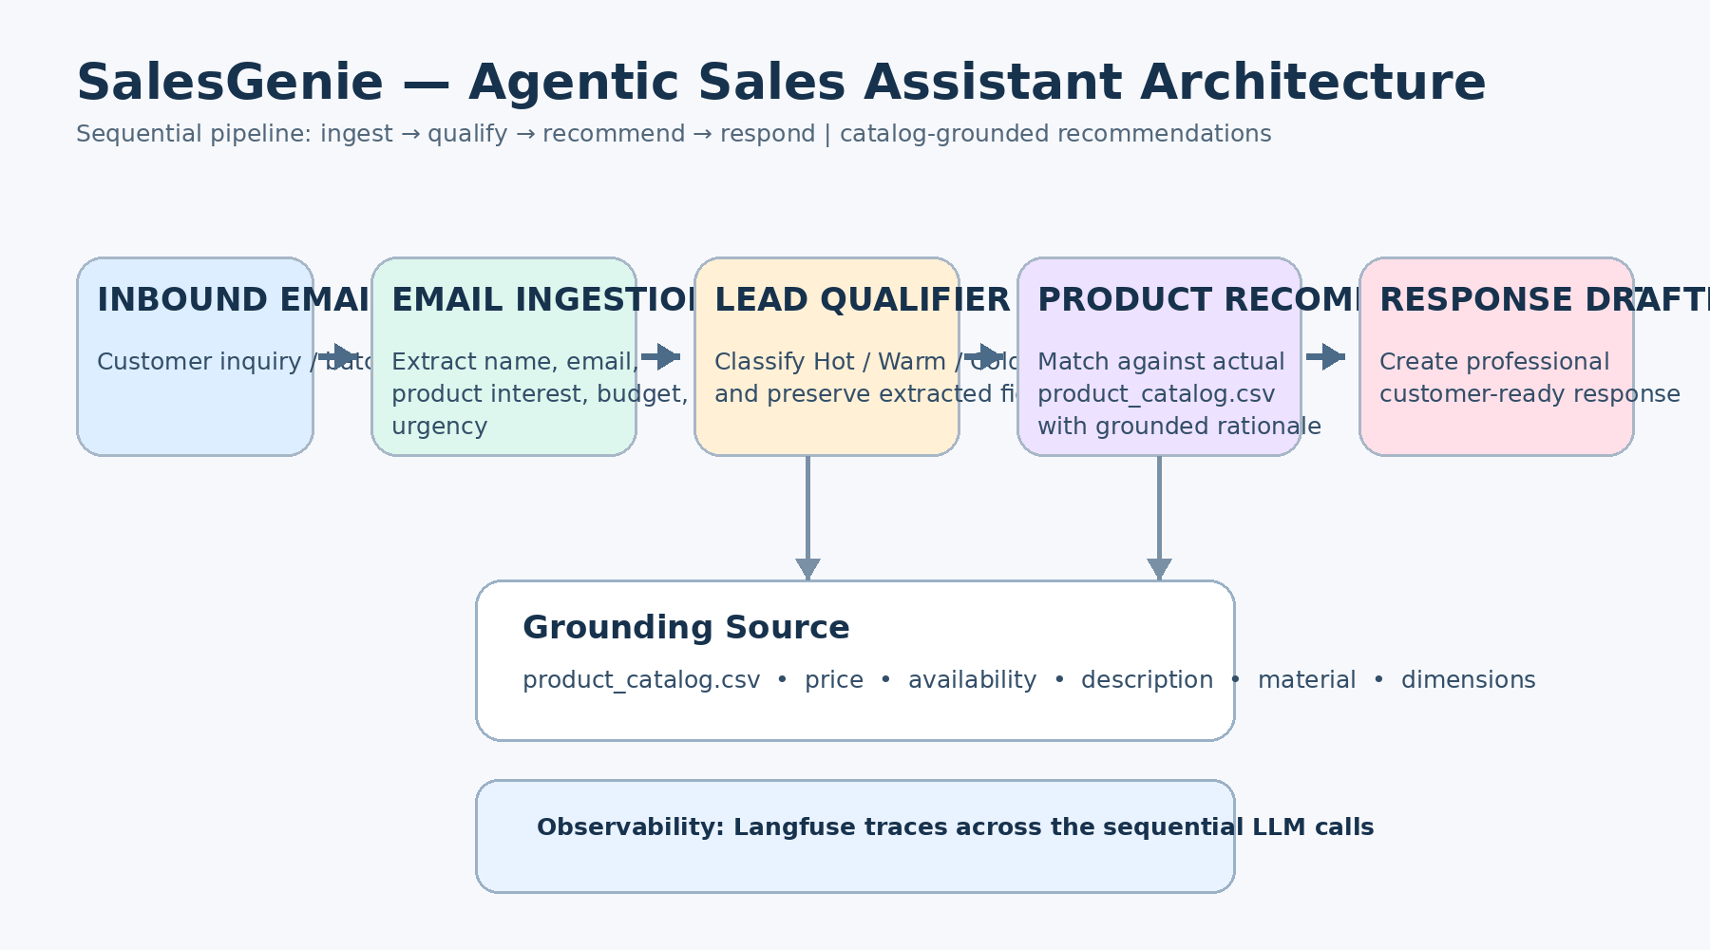
Architecture
Sequential multi-agent pipeline
SalesGenie • Mahesh Zade • 9/25

Slide 10
Why Sequential Pipeline?
The capstone recommends a fixed-order pattern for SalesGenie
Every normal inquiry follows the same stages in order
Sequential processing is simpler and easier to test than an unnecessarily complex hierarchy
A Router can be added after ingestion for inquiry vs complaint vs spam
Weekly Aggregator is a separate scheduled path
PATTERN
Inbound → Ingest → Qualify → Recommend → Respond
SalesGenie • Mahesh Zade • 10/25

Slide 11
Agent 1 — Email Ingestion
Structured extraction with UNKNOWN for unstated fields
INPUT
GROUNDING RULE
Raw inquiry email
Output fields:
name • email • product_interest • budget • urgency
If a field is not explicitly stated, return UNKNOWN rather than guessing or inferring.
SalesGenie • Mahesh Zade • 11/25

Slide 12
Agent 2 — Lead Qualifier
Standardized Hot / Warm / Cold classification
Input: extracted JSON
Output: previous fields + lead_tier
Allowed tiers: Hot / Warm / Cold
High confidence threshold before Hot
Spam / non-lead should not be treated as a lead
SalesGenie • Mahesh Zade • 12/25

Slide 13
Agent 3 — Product Recommender
Catalog-grounded matching and rationale
CATALOG INPUT
MATCHING
OUTPUT
product_catalog.csv is injected into the prompt.
Use product interest, budget and urgency.
Top matching products + rationale.
SalesGenie • Mahesh Zade • 13/25

Slide 14
Agent 4 — Response Drafter
Professional, personalized customer communication
Receives recommender output
Formats a professional, warm email
Includes product recommendations, pricing and call to action
Current exported prompt hard-codes “Sarah” — this should be made dynamic before final submission
SalesGenie • Mahesh Zade • 14/25

Slide 15
Data Grounding & Guardrails
The catalog must remain the source of truth
SOURCE OF TRUTH
GUARDRAILS
ROUTING
Product name
Price
Availability
Description
Material
Dimensions
No invented products
No invented pricing
No unsupported features
No false stock status
Product questions ≠ leads
Spam ≠ leads
Weekly summary ≠ recommendation
SalesGenie • Mahesh Zade • 15/25

Slide 16
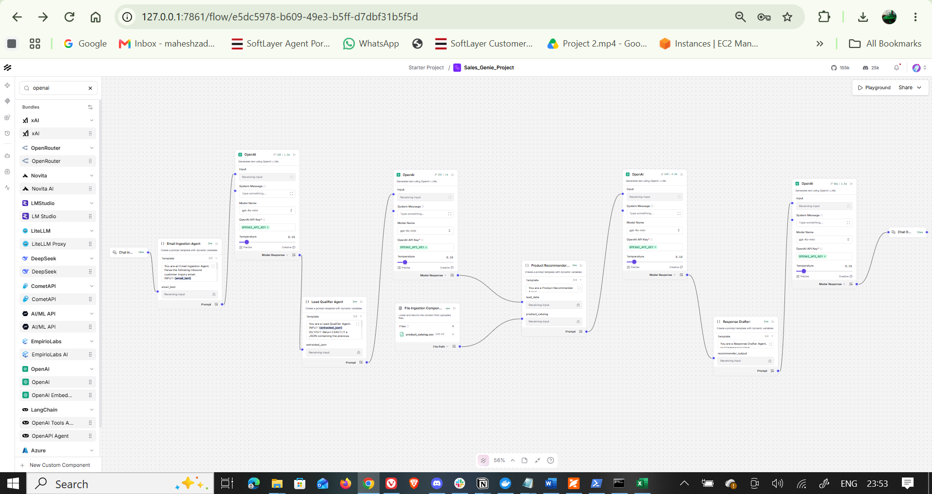
Workflow Evidence
Supplied LangFlow canvas and exported JSON
SalesGenie • Mahesh Zade • 16/25

Slide 17
Observability with Langfuse
Trace the multi-agent execution
Supplied project documentation describes Langfuse observability
Trace the parent-child execution of the sequential LLM calls
Useful signals: input/output, token usage, latency, cost and error patterns
Use traces to identify hallucinations and prompt failures
OBSERVABILITY GOAL
Move from “it ran” to “we can explain what happened and why.”
SalesGenie • Mahesh Zade • 17/25

Slide 18
Evaluation Framework
11 baseline inputs + measurable quality metrics
Baseline: T1–T11
Metrics: extraction completeness, lead-tier accuracy, catalog-grounded recommendation rate
Safety/quality: hallucination rate and out-of-stock correctness
Operations: response turnaround time and cost per lead
Evidence: actual outputs + Langfuse traces
SalesGenie • Mahesh Zade • 18/25

Slide 19
Baseline Review — T1 to T4
Observed results from the supplied workbook
T1
Scenario
Expected
Observed
FAIL
Standing desk < $800, dark walnut
Hot/Warm + catalog product < $800
Supplied output recommends 'ErgoLift Standing Desk' and 'FlexiDesk Pro', neither is in supplied catalog.
T2
Scenario
Expected
Observed
FAIL
Vague furniture inquiry
Cold + ask for budget/type/requirements
Supplied output recommends two specific products instead of asking clarifying questions.
T3
Scenario
Expected
Observed
FAIL
10 ergonomic chairs, $5,000 total, urgent
Hot + chairs <= $500 each + urgency
Supplied output uses 'ErgoChair Pro' and 'ComfortMax Ergonomic Chair', not the catalog names.
T4
Scenario
Expected
Observed
FAIL
Oak desk color question
Product question; no lead tier
Supplied output turns it into a product recommendation email and classifies implicitly as a lead.
SalesGenie • Mahesh Zade • 19/25

Slide 20
Baseline Review — T5 to T8
Grounding, spam and context issues
T5
Scenario
Expected
Observed
FAIL
Compare standing desks with IKEA
Warm/Hot + actual catalog differentiators
Supplied output uses non-catalog products and unsupported review/availability claims.
T6
Scenario
Expected
Observed
FAIL
Something nice under $50
Appropriate classification + catalog item under $50 or no availability
Supplied output recommends 'Elegant Candle Set' and 'Stylish Tote Bag', neither is in catalog.
T7
Scenario
Expected
Observed
FAIL
Spam message
Spam/not valid inquiry; no recommendation
Supplied output generates a product recommendation email.
T8
Scenario
Expected
Observed
FAIL
12-person conference table, $3,000, law firm
Hot + catalog conference table + firm context
Supplied output recommends non-catalog table names and unsupported specifications.
SalesGenie • Mahesh Zade • 20/25

Slide 21
Baseline Review — T9 to T11
Vague, availability and weekly-summary issues
T9
Scenario
Expected
Observed
FAIL
furniture please
Cold + request details; no invented requirements
Supplied output recommends a sofa and dining table without enough information.
T10
Scenario
Expected
Observed
FAIL
Walnut Executive Desk availability
Report catalog stock accurately; must not say available
Catalog says Walnut Executive Desk is Out of Stock; supplied output says two walnut desks are readily available.
T11
Scenario
Expected
Observed
FAIL
Generate weekly summary
Total leads + Hot/Warm/Cold + categories + average budget
Supplied output is a generic recommendation email, not a weekly summary.
SalesGenie • Mahesh Zade • 21/25

Slide 22
Key Findings & Corrective Actions
What must be fixed before claiming a passing baseline
0 / 11
PRIMARY GAP
NEXT RUN
Observed passing tests in the supplied workbook when checked against the supplied catalog.
Invented/non-catalog products and unsupported claims.
Correct grounding + routing, then rerun T1–T11.
T10 must report Walnut Executive Desk as Out of Stock.
T11 needs a real weekly aggregation path.
Response Drafter should use the extracted customer name dynamically.
SalesGenie • Mahesh Zade • 22/25

Slide 23
Cost & KPI Strategy
Measure quality, speed, hallucination and unit economics
QUALITY
SPEED
ECONOMICS
Tier accuracy
Grounded recommendation rate
Hallucination rate
Response turnaround
Manual hours saved
Weekly reporting time saved
Cost per lead = total AI/platform cost ÷ processed leads
Use thresholds to decide whether the system is ready for broader rollout.
Track quality by agent, not only by final response.
SalesGenie • Mahesh Zade • 23/25

Slide 24
Rollout, Privacy & Next Steps
Controlled pilot for 20 reps
Pilot with a small group before rollout to 20 reps
Human review for customer-facing recommendations during pilot
Protect inquiry/CRM data and never commit API secrets to GitHub
Add rollback criteria and monitored quality thresholds
Rerun T1–T11 and capture final Langfuse evidence
NEXT MILESTONE
Verified baseline + trace evidence + corrected routing/grounding
SalesGenie • Mahesh Zade • 24/25

Slide 25
Conclusion & Thanks
Mahesh Zade • Special Thanks to Gautam Muthukumar & Interview Kickstart
SalesGenie
A practical, grounded and observable sales-assistance pattern
Mahesh Zade
Special Thanks to Gautam Muthukumar for completing the Project and the Interview Kickstart team
SalesGenie • Mahesh Zade • 25/25

